Slide 1
Data Analysis of Hotel Booking
- By Mitul Patidar

Slide 2
Business Problem
In recent years, city hotel and resort hotel seen high cancellation rates, Each is now dealing with umber of issues as a result, including fewer revenues and less than ideal hotel room use. Consequently, lowering cancellations rates in both hotels primary goal is order to increase their efficiency in generating revenue and for us to offer through business advice to address this problem
Analysis of hotel booking cancellations as well as other factors that have now bearing on their business and yearly revenue generation are the main topics to this report.

Slide 3
Assumptions
No usual occurrence between 2015 and 2017 will have a sustainable impact on data used.
The information is still current and can be used to analyse a hotel possible plans in efficient manner
There are no unanticipated negatives to hotel employing any advised technique.
The hotel are not currently using any of suggested solutions
The biggest factor affecting the effectiveness of earning income is booking cancellations.
Cancellations result in vacant rooms for the booked length of time
Clients make hotels reservations, the same year they make cancellations

Slide 4
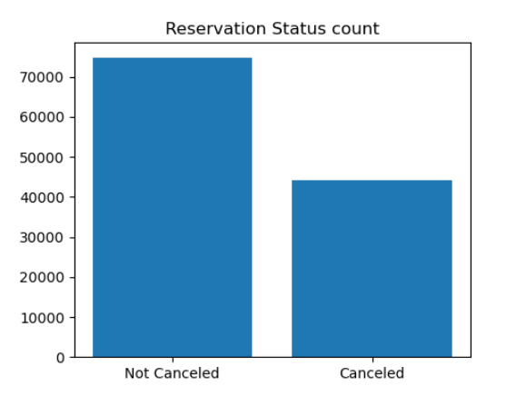
Data Visualizations and Analysis
The above bar graph shows the percentage of reservations that are canceled are those that are not. Its obvious that there are still significant number of reservations that have not canceled.
There are still 37% of clients who canceled their reservation, which has significant impact in the hotels earnings

Slide 5
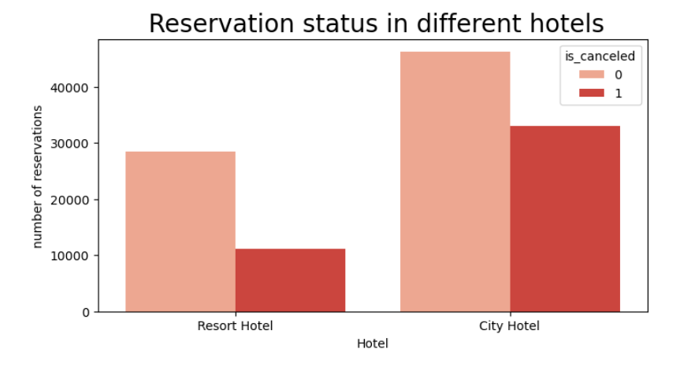
On comparing, city hotel have more bookings, Its possible that resort hotel are more expensive than city hotel

Slide 6
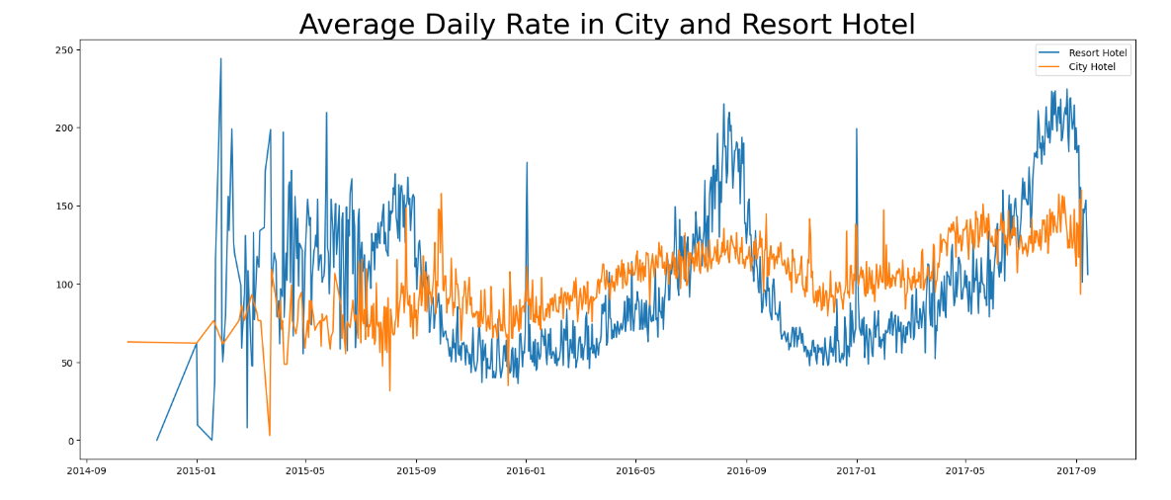
Line graph shows that on certain days, the average daily rate of resort hotel is more than the city hotel, weekends and holidays are seen more rise in resort hotel rates

Slide 7
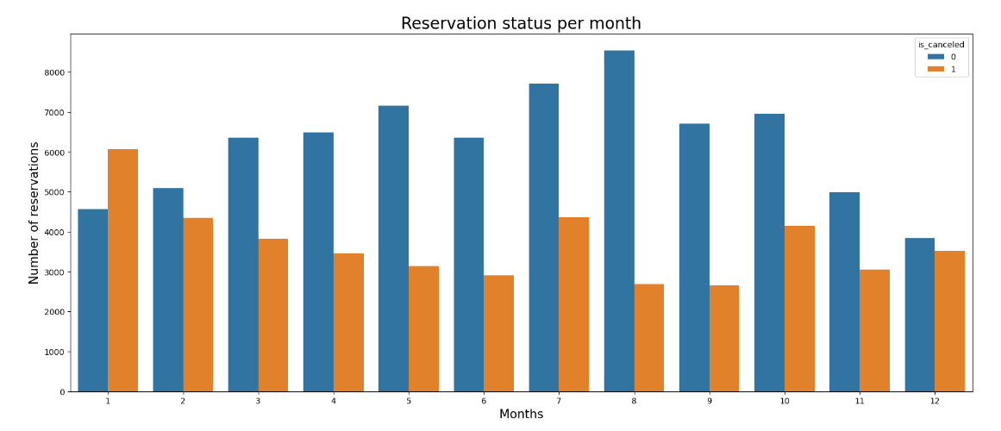
Above bar plot shows between months and number of reservations i.e. highest and lowest reservation levels according to reservations status.
As seen in above plot both number of confirmed reservation and number of cancelled reservation are seen in August respectively, Whereas in January most canceled reservation

Slide 8
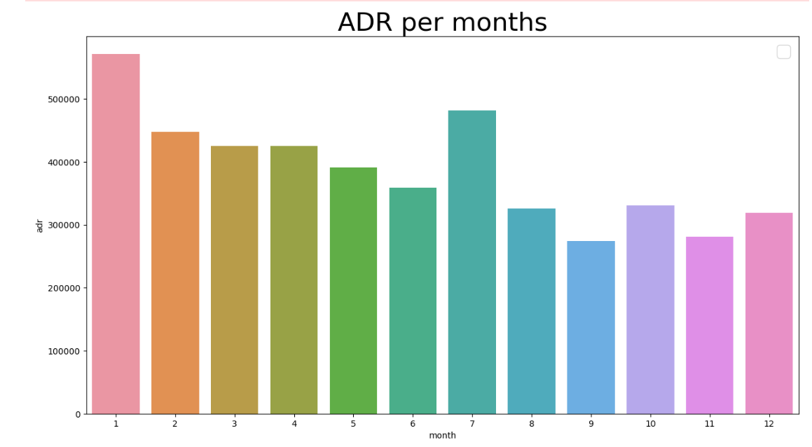
This bar graph tells that cancellations are most common when prices are greatest and are the least common when they are lowest, Therefore, the cost of accommodation is solely responsible for the cancellation

Slide 9
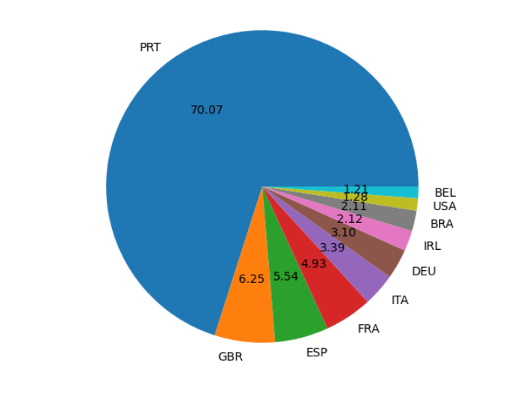
Portugal Country is the highest number of cancellation, serious action to be taken place.

Slide 10
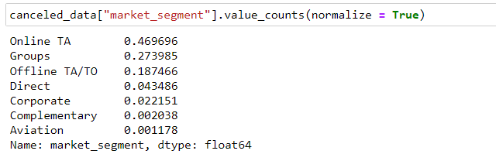
46% are comes from online travel agencies, 27% of comes from the groups, 4% are comes from visiting the hotel directly.

Slide 11
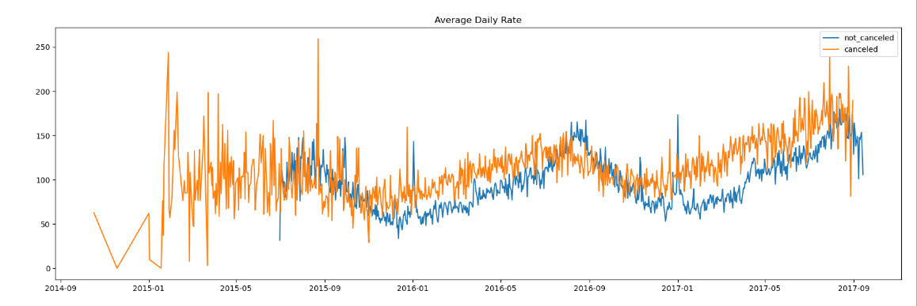
As seen in the graph that average daily rate is higher than when it is not canceled, therefore it tells that higher prices leads to higher cancellation

Slide 12
Suggestions for hotels
Cancellation rates rise as the prices are more, in order to reduce this work on pricing strategies and try to lower the rates for specific hotels based on locations.
Have to increase the quality of the hotels and services in the Portugal
In month of January, hotels can start campaign and provide best service.
Provide some reasonable amount of discounts in weekends and holidays, because cancellation and not cancellation ratio is more

